Slide 1
Microsoft Azure
Abhijeet Kumar
Ashok IT

Slide 2
Azure Bootcamp Syllabus
Syllabus:
Cloud Computing Intro
Azure fundamentals
Cloud Service Type
Azure architectural Component and Azure Subsrcription
Compute and Networking (VM, VPN,Azure App services etc)
Storage
Identity Access and Management
Resource Deployment
Different Monitoring tools
App Deployment.
Course Duration: 3-4 weeks
Note: End of course will have a Combined test on above topics.

Slide 3
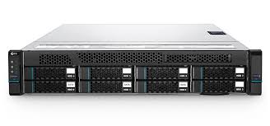
Server
What is Server?
A server is a computer that provides services to other computers.

Slide 4

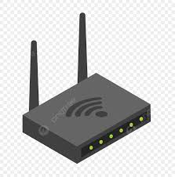

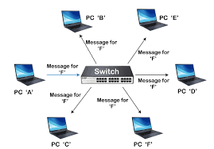
IT Infrastructure
IT Infrastructure

Slide 5

Data center

Slide 6
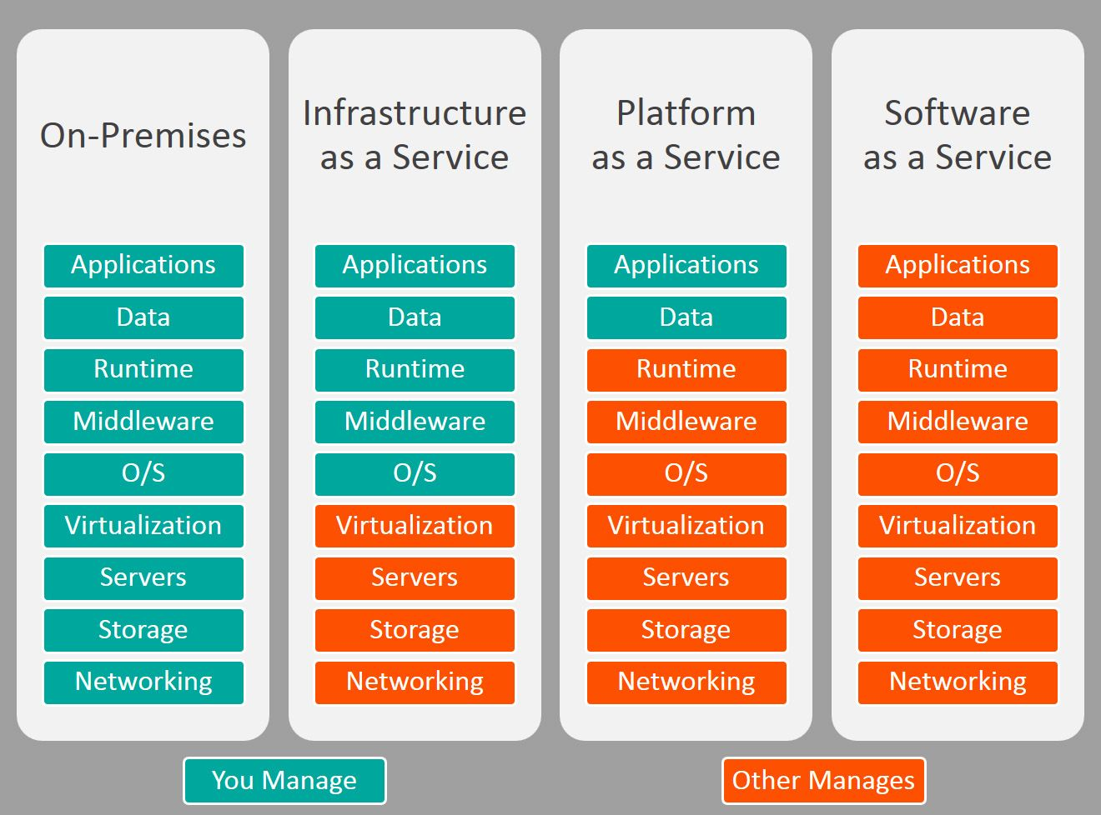

Slide 7
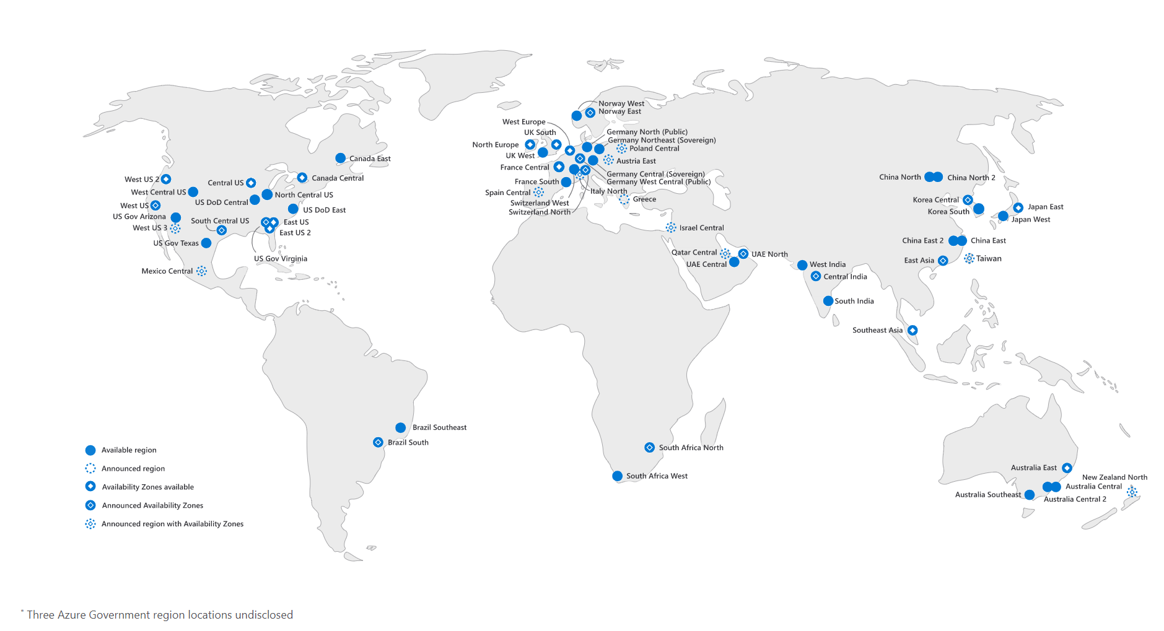
Regions

Slide 8
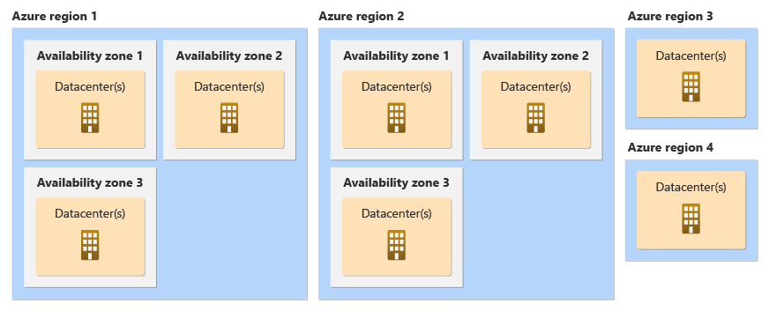
Availability Zones

Slide 9
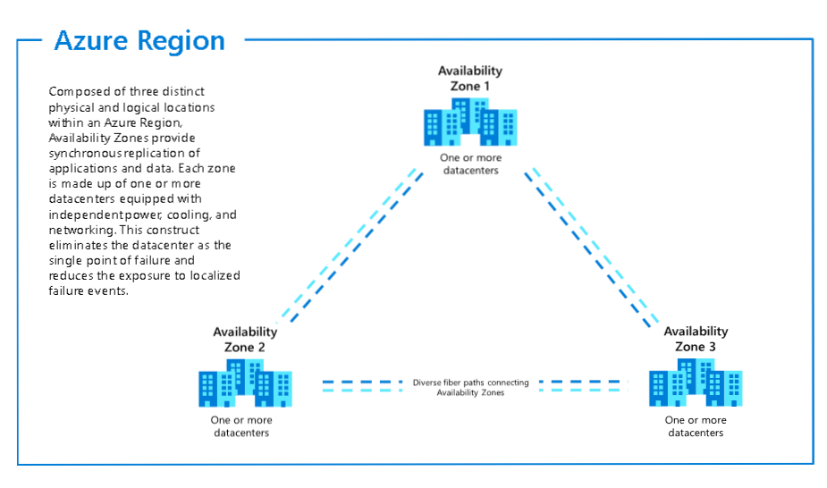
Availability Zones

Slide 10
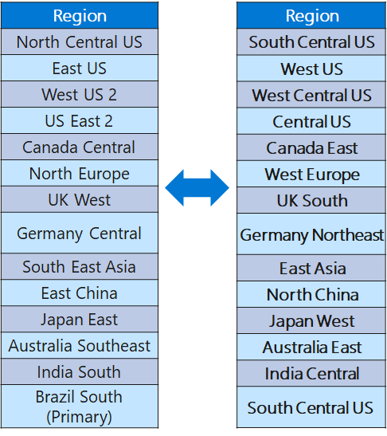
Regional Pairs

Slide 11
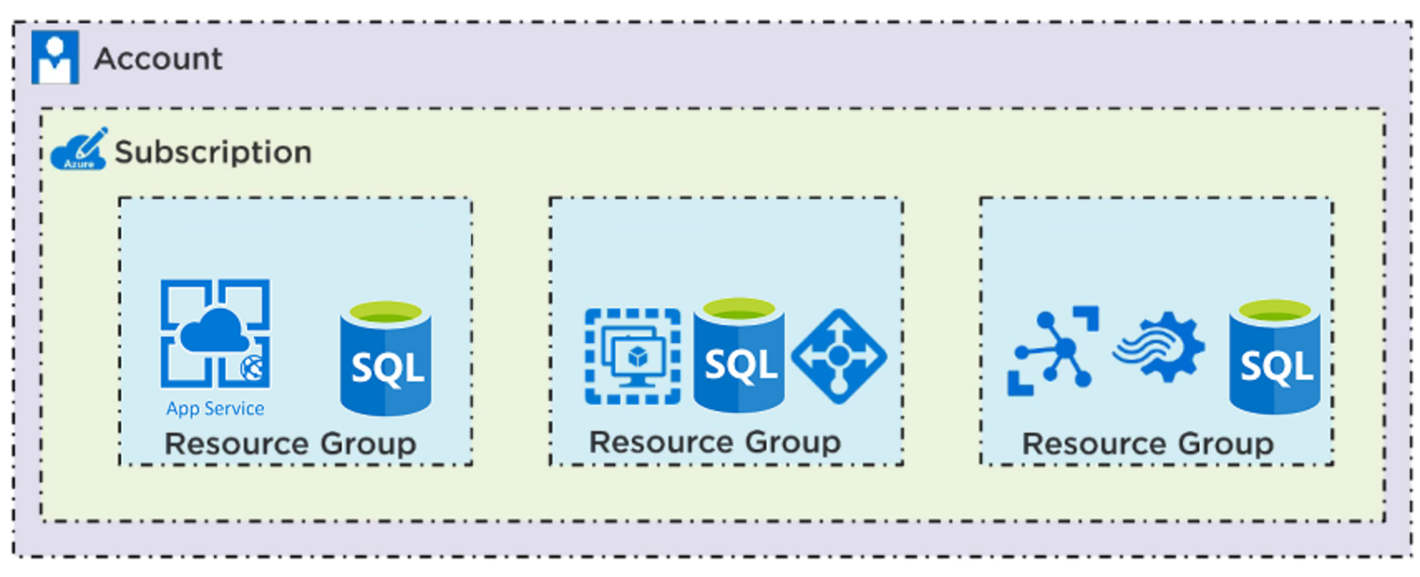

Slide 12
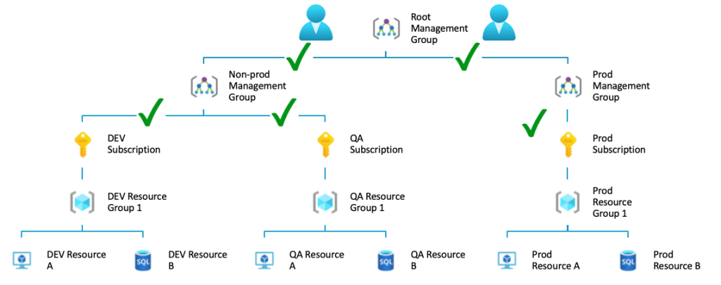

Slide 13
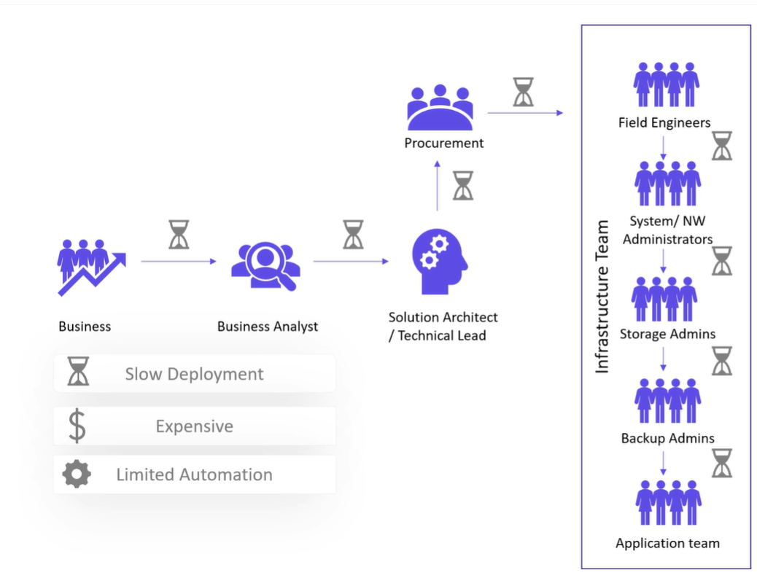

Slide 14
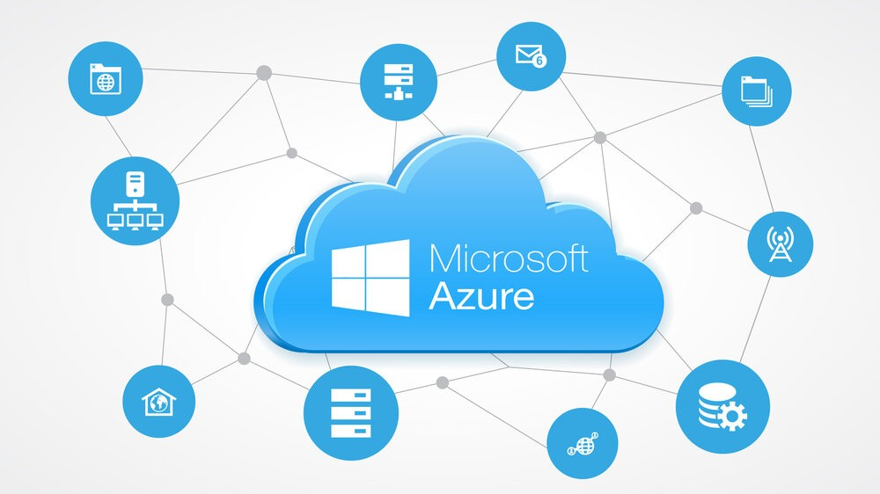

Slide 15
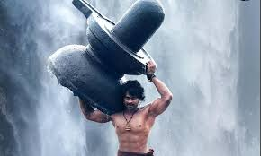
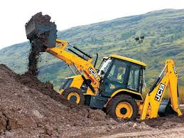
Azure
What am I trying to tell?

Slide 16
Why Automation?
Why Automation?
-Definitely to reduce time
-Reduce human error
-Standarisation

Slide 17
Different ways to automate in azure:
These are also called as infrastructure as code
ARM Template
Bicep
SDK
Azure CLI
Terraform

