Slide 5
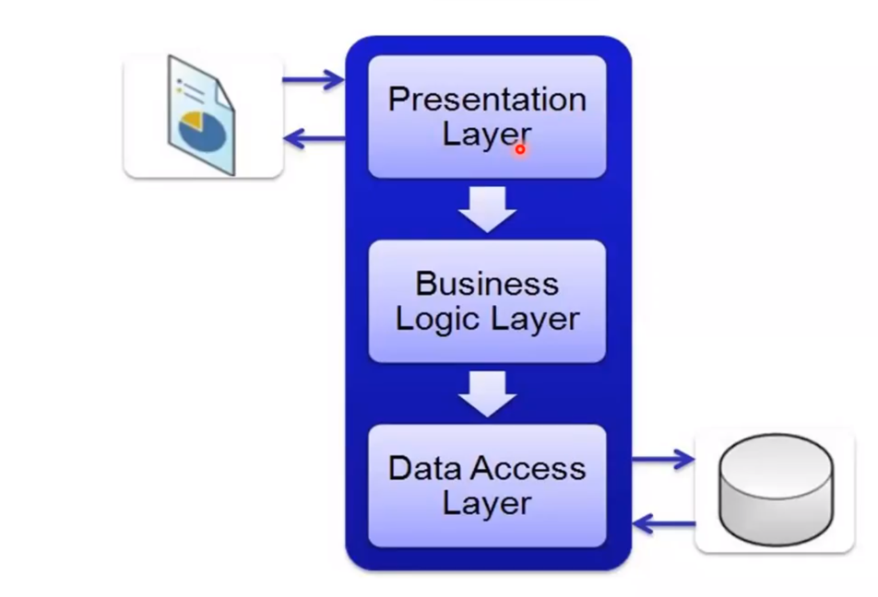
Bb b b hbhhn m

Slide 7
BNjn hn H h HN H Q HB n a

