Slide 1
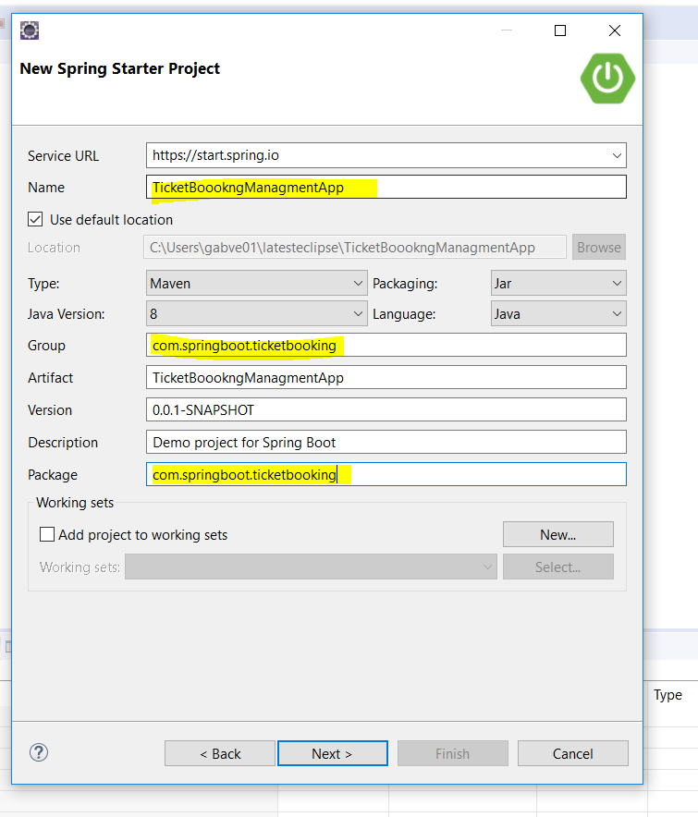

Slide 2
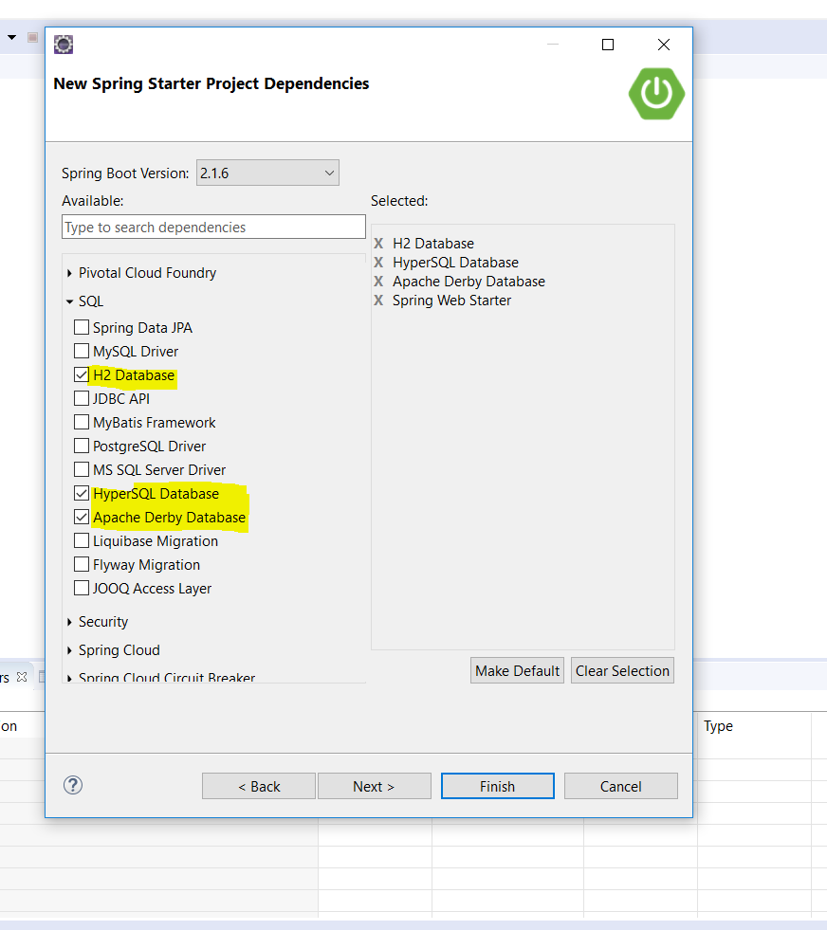
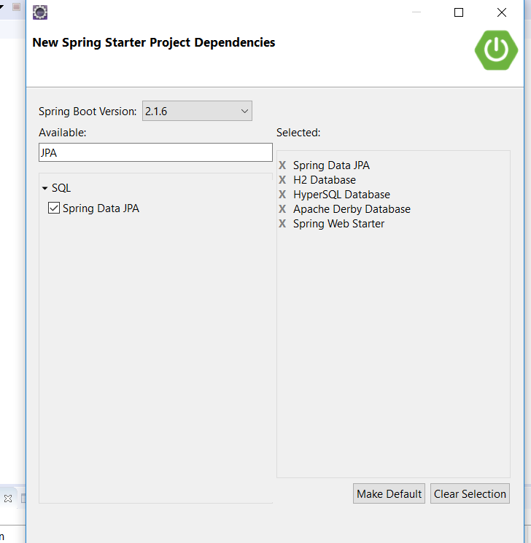

Slide 3
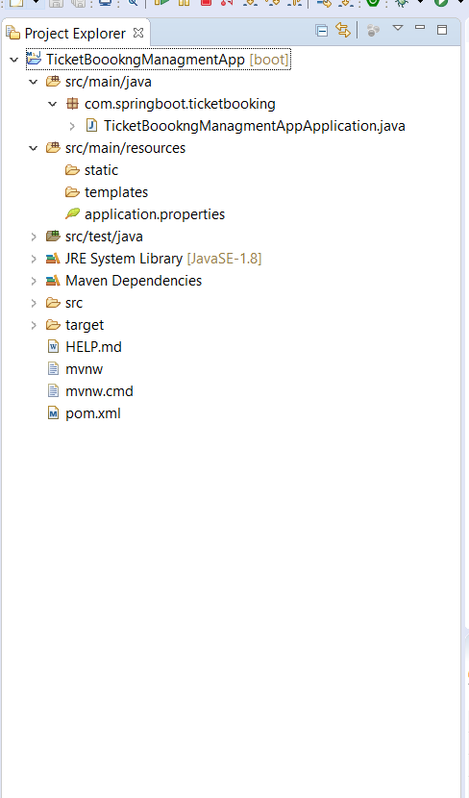
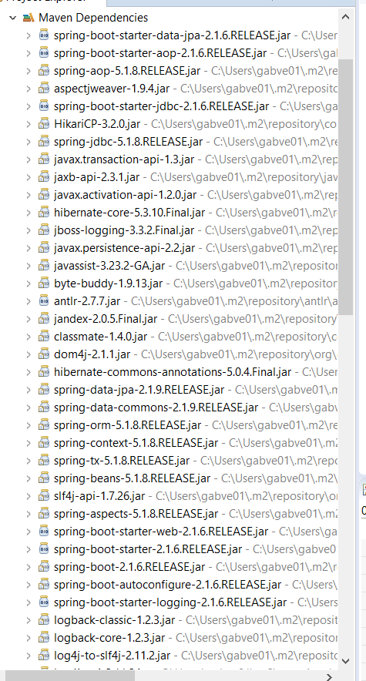

Slide 4
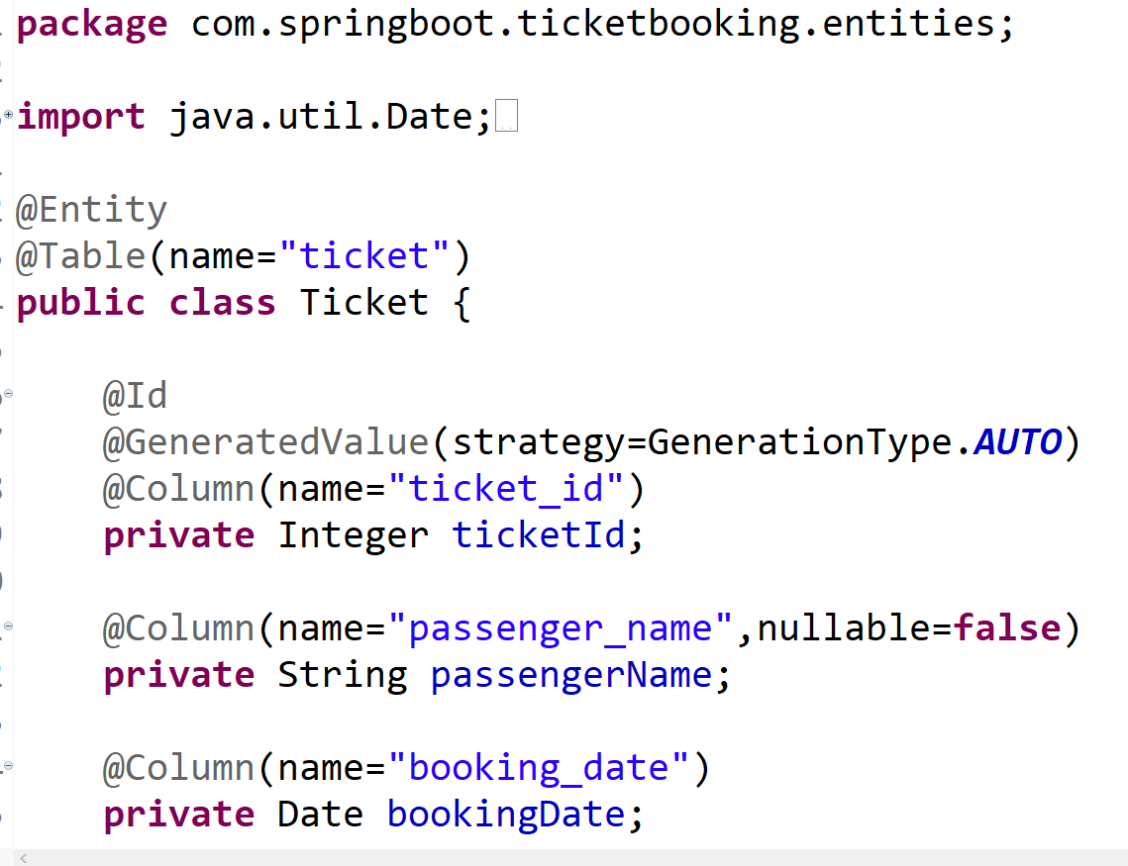

Slide 5
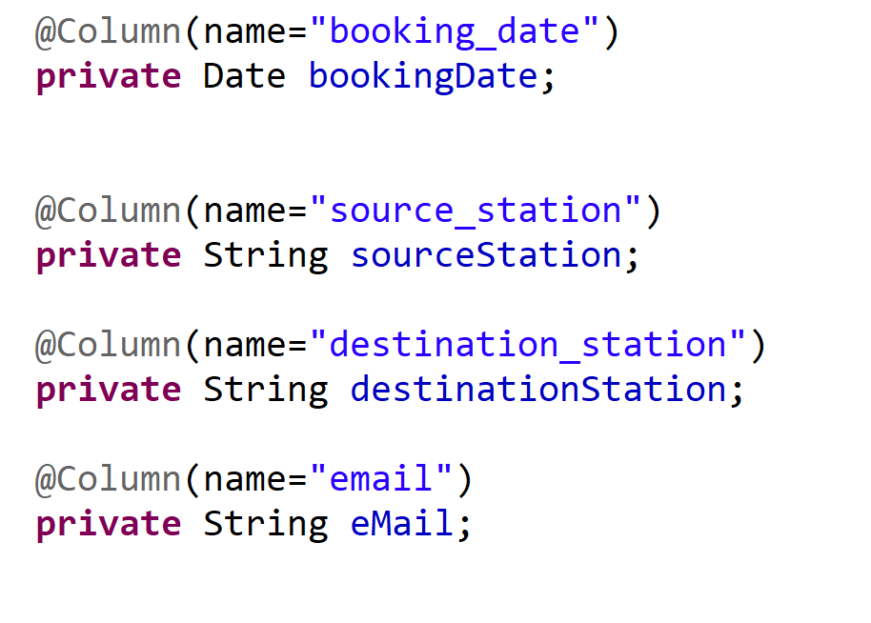

Slide 6
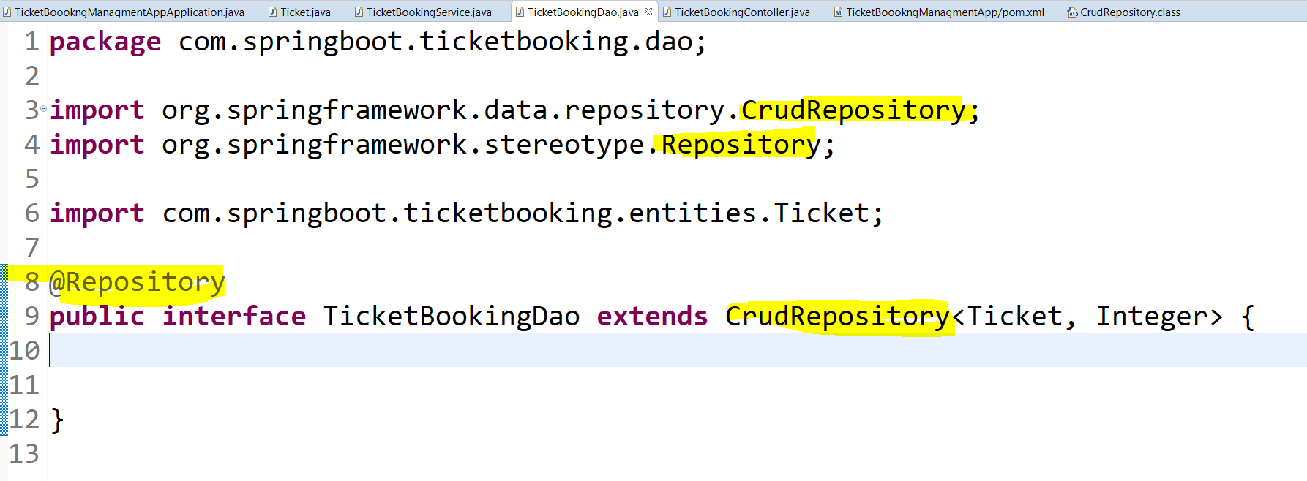

Slide 7
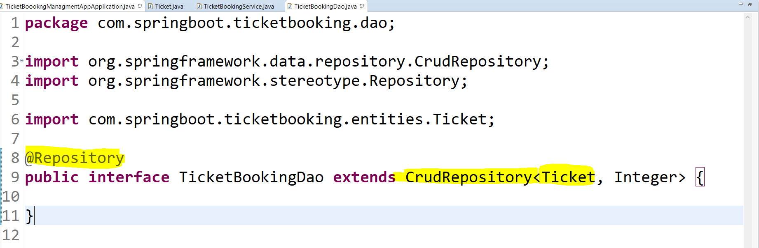

Slide 8
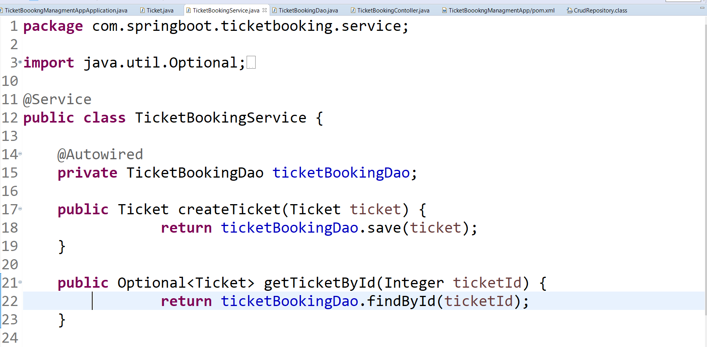

Slide 9
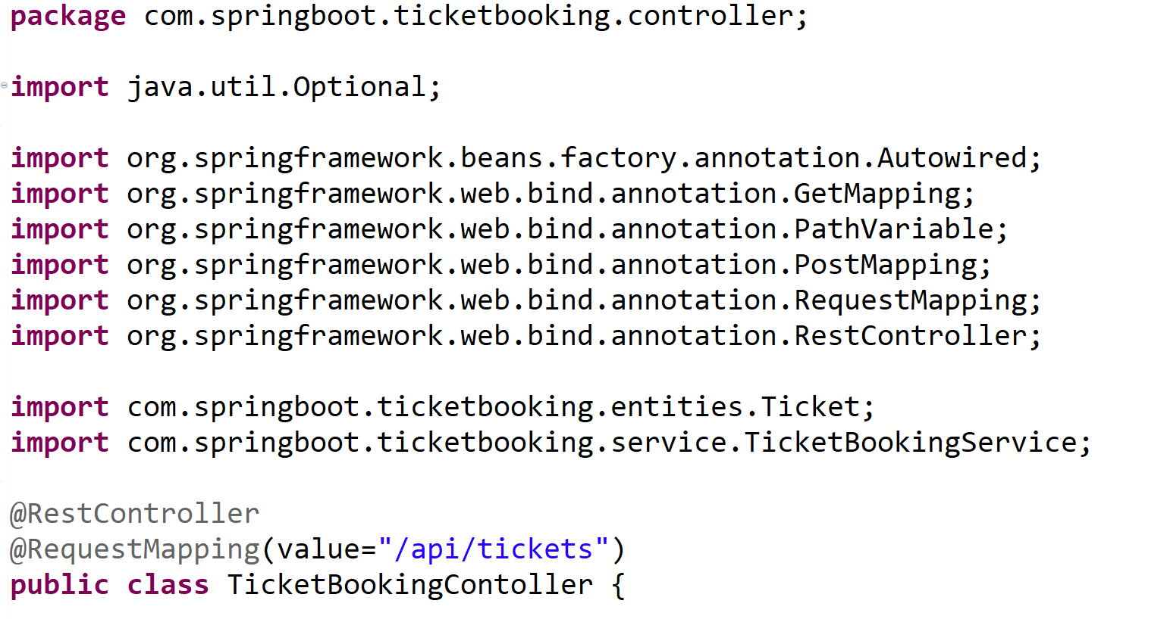

Slide 10
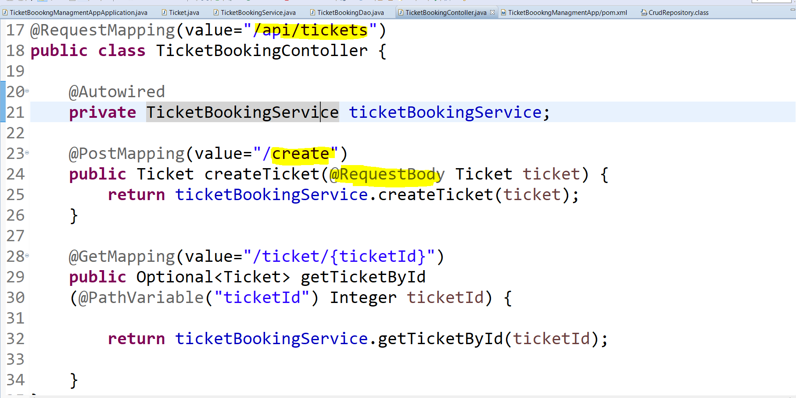

Slide 11
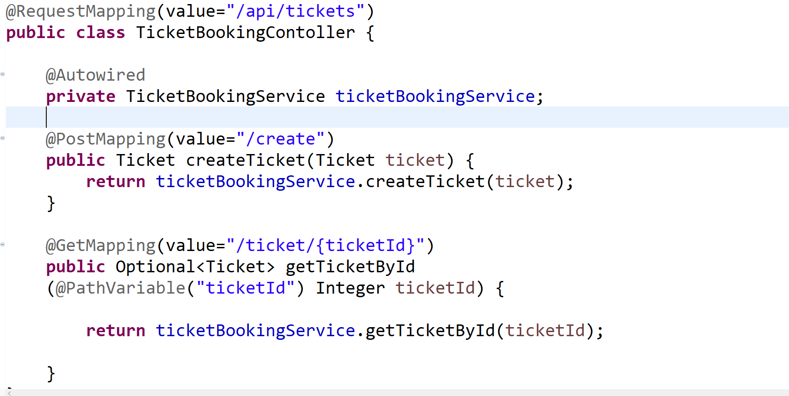

Slide 12
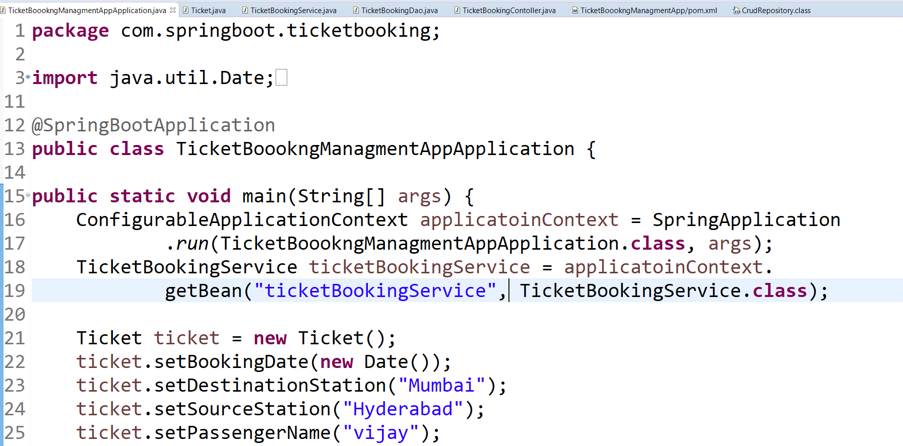
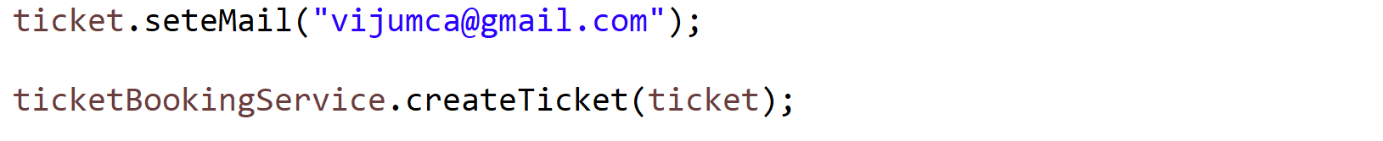

Slide 13
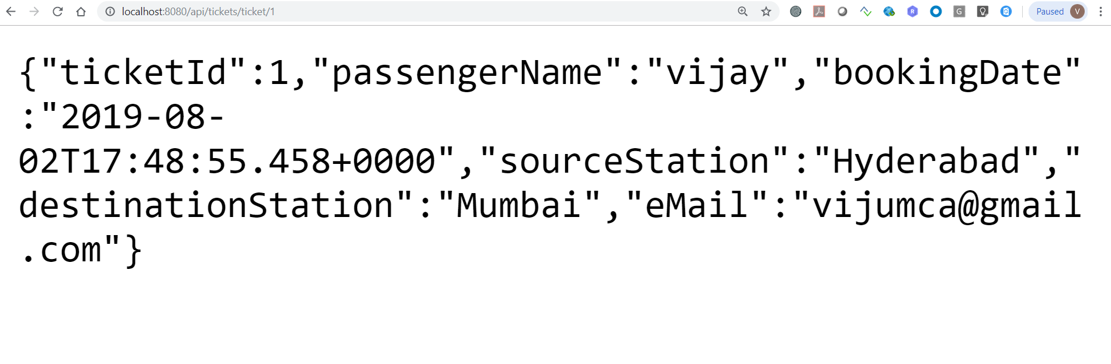

Slide 14
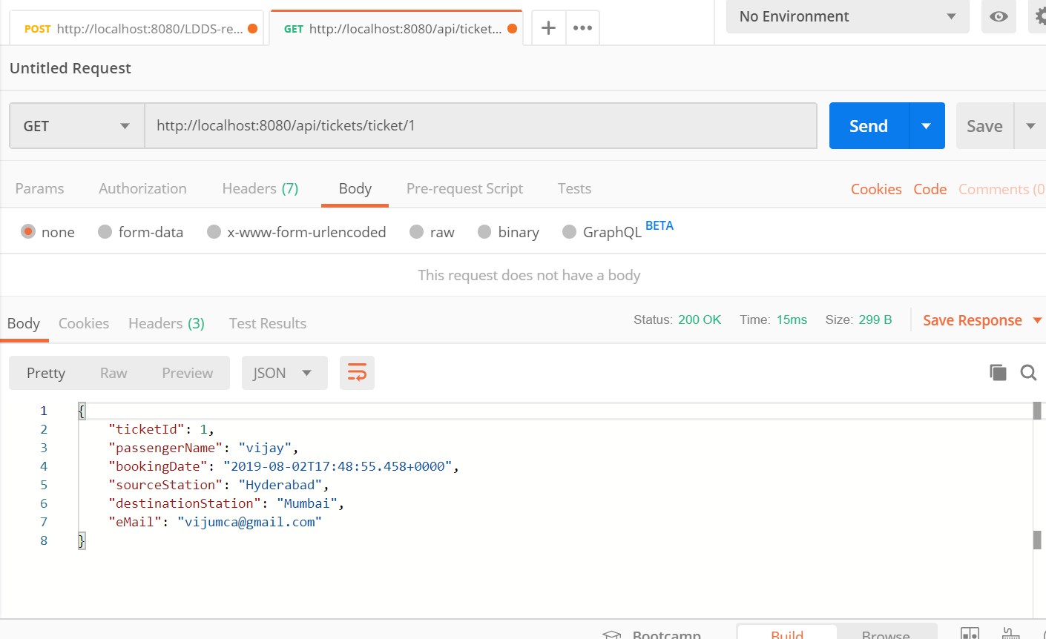

Slide 15
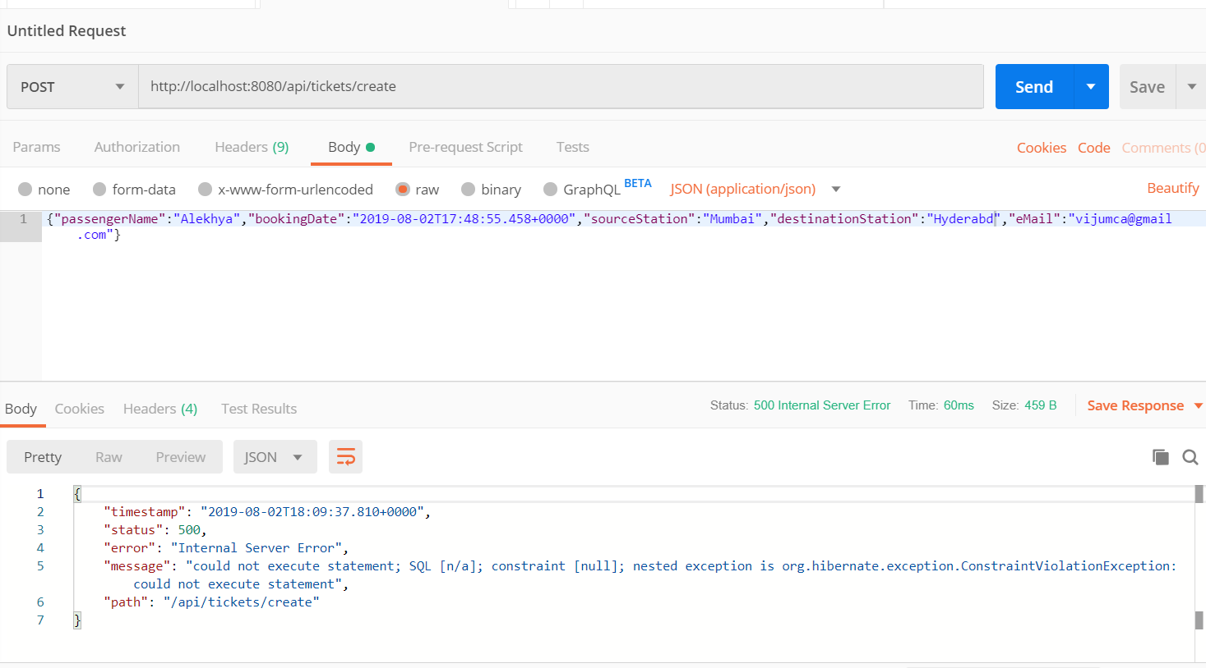

Slide 16
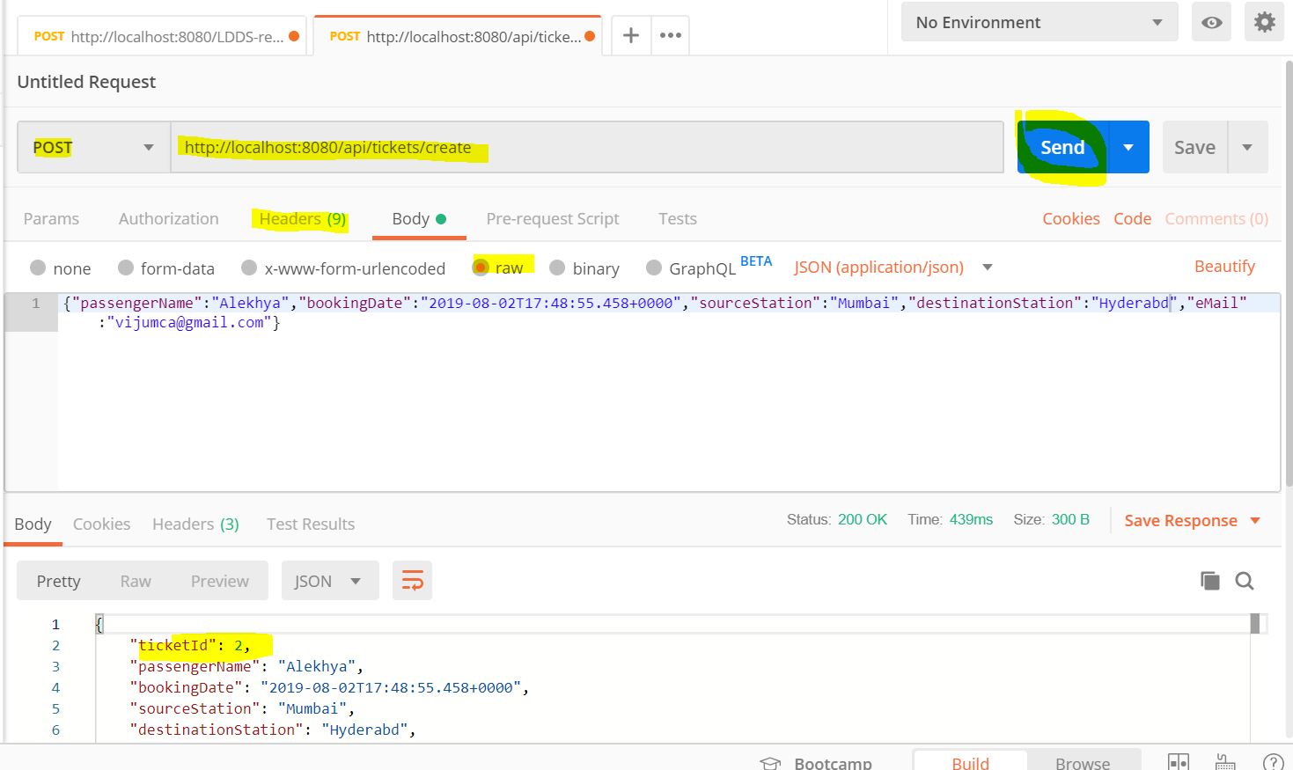

Slide 17
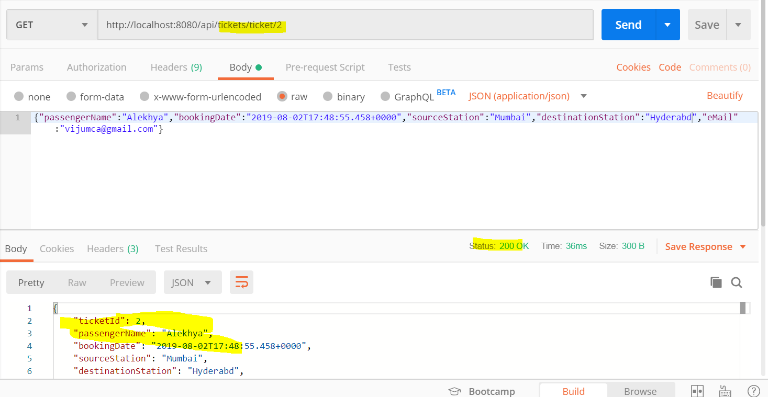

Slide 18
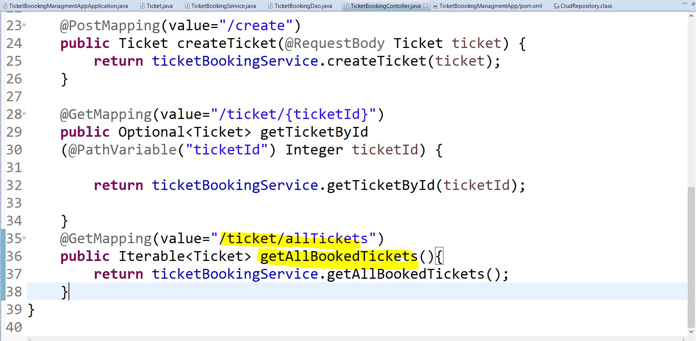

Slide 19
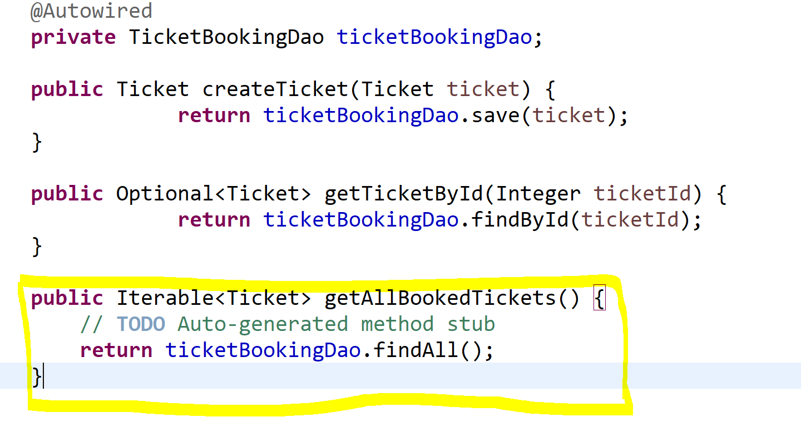

Slide 20
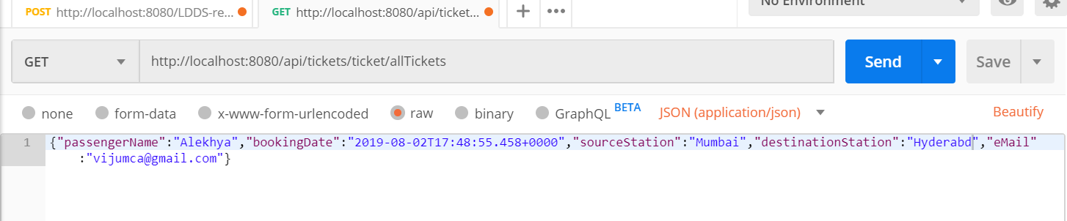
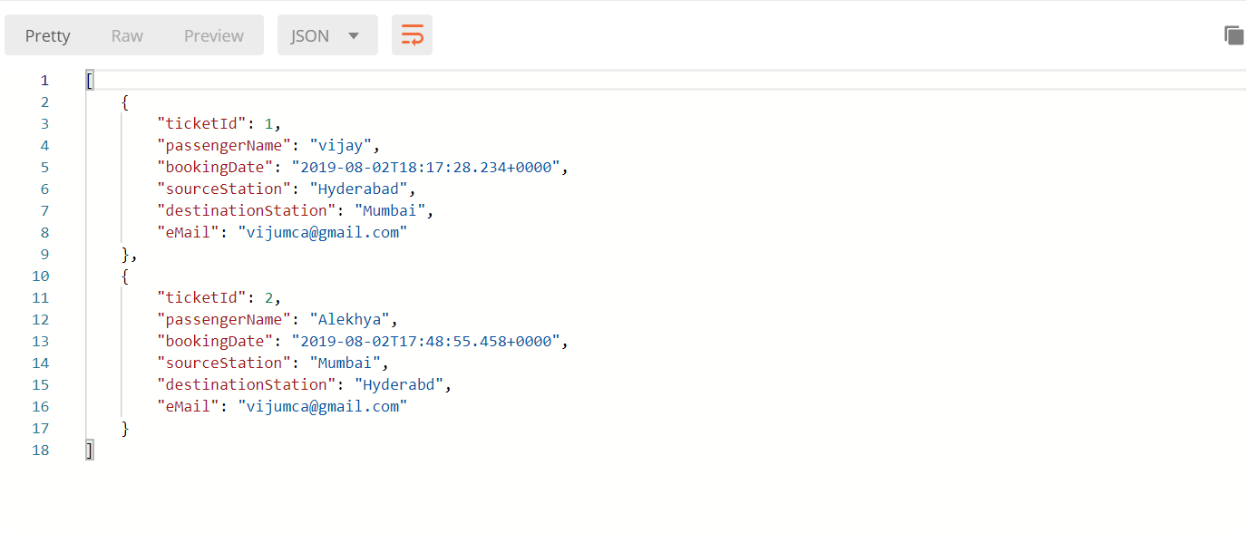

Slide 21
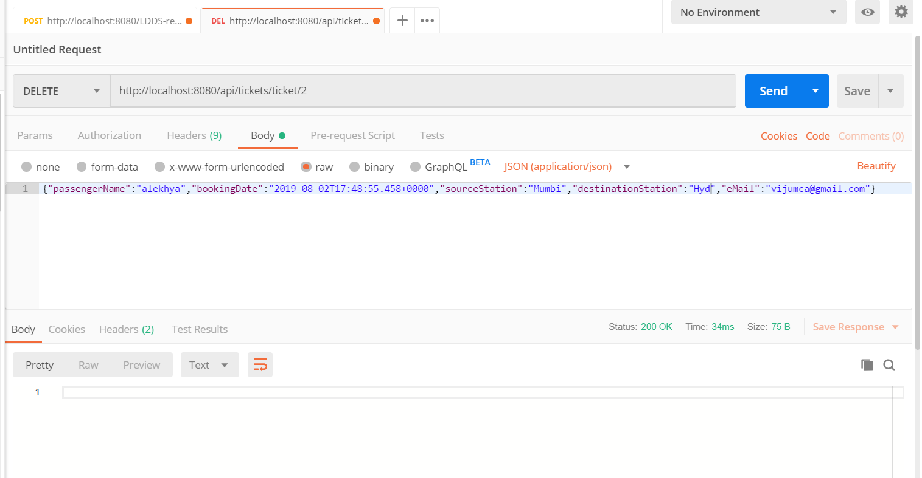

Slide 22
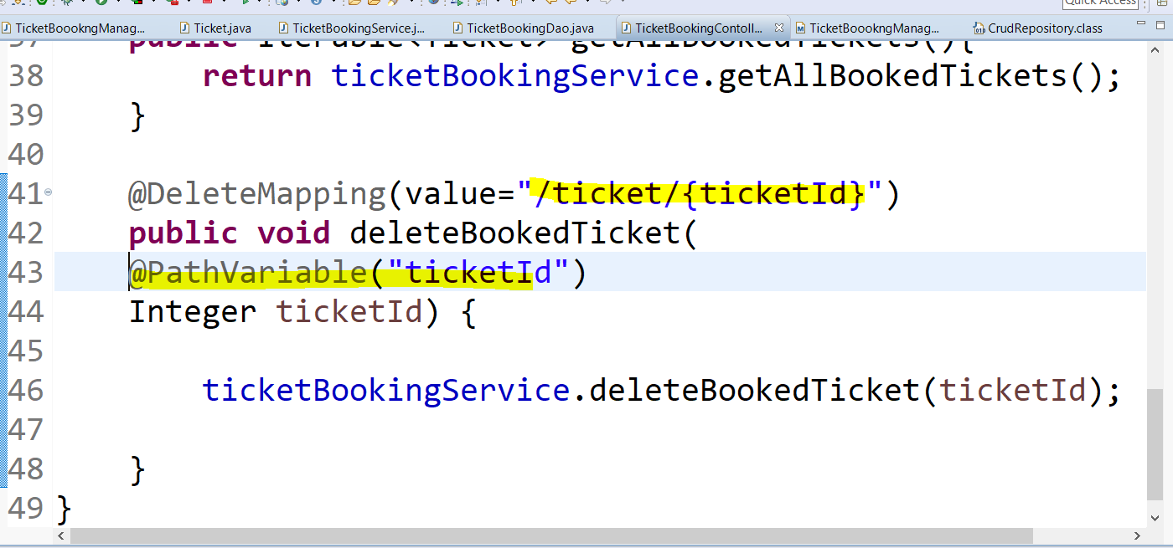

Slide 23
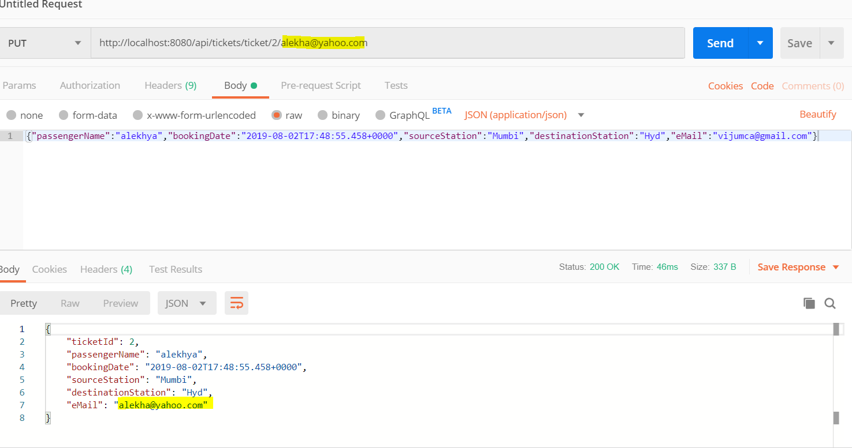

Slide 24
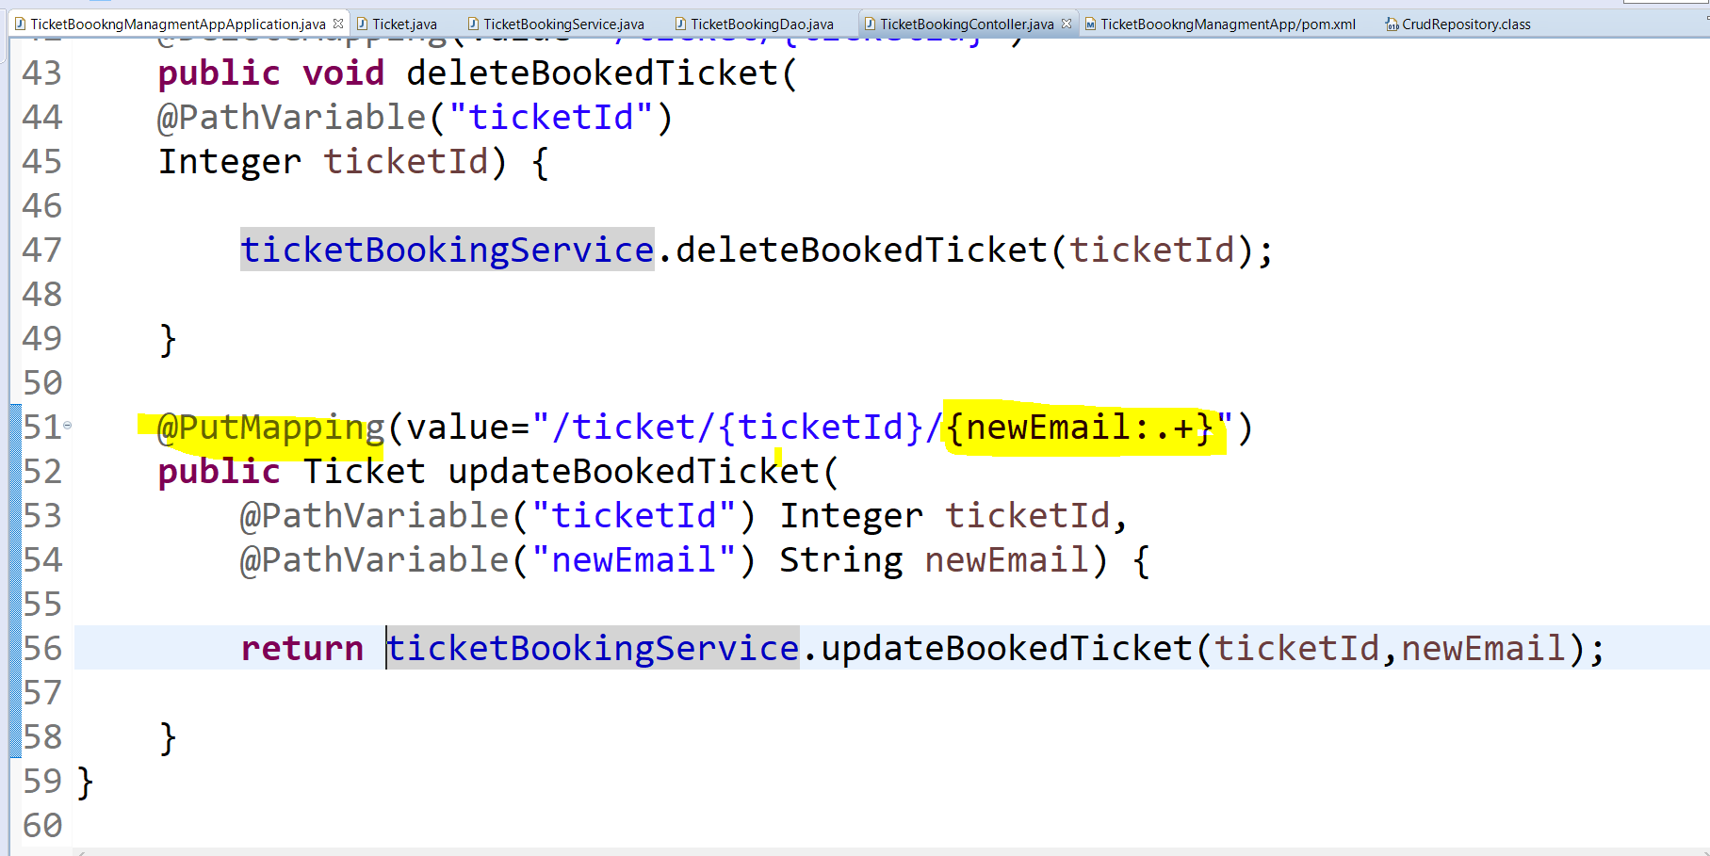

Slide 25
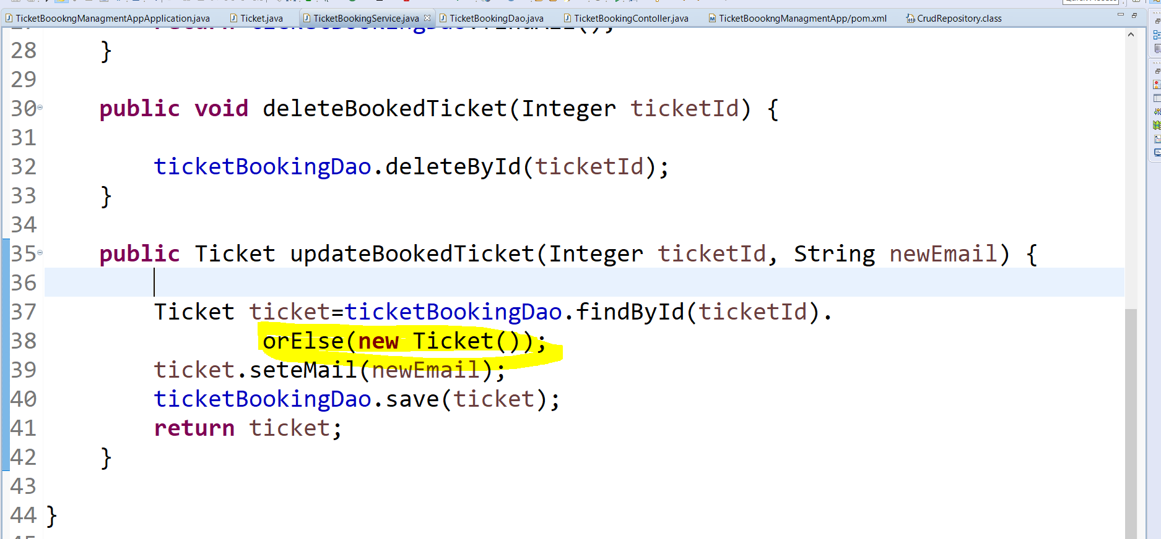

Slide 26
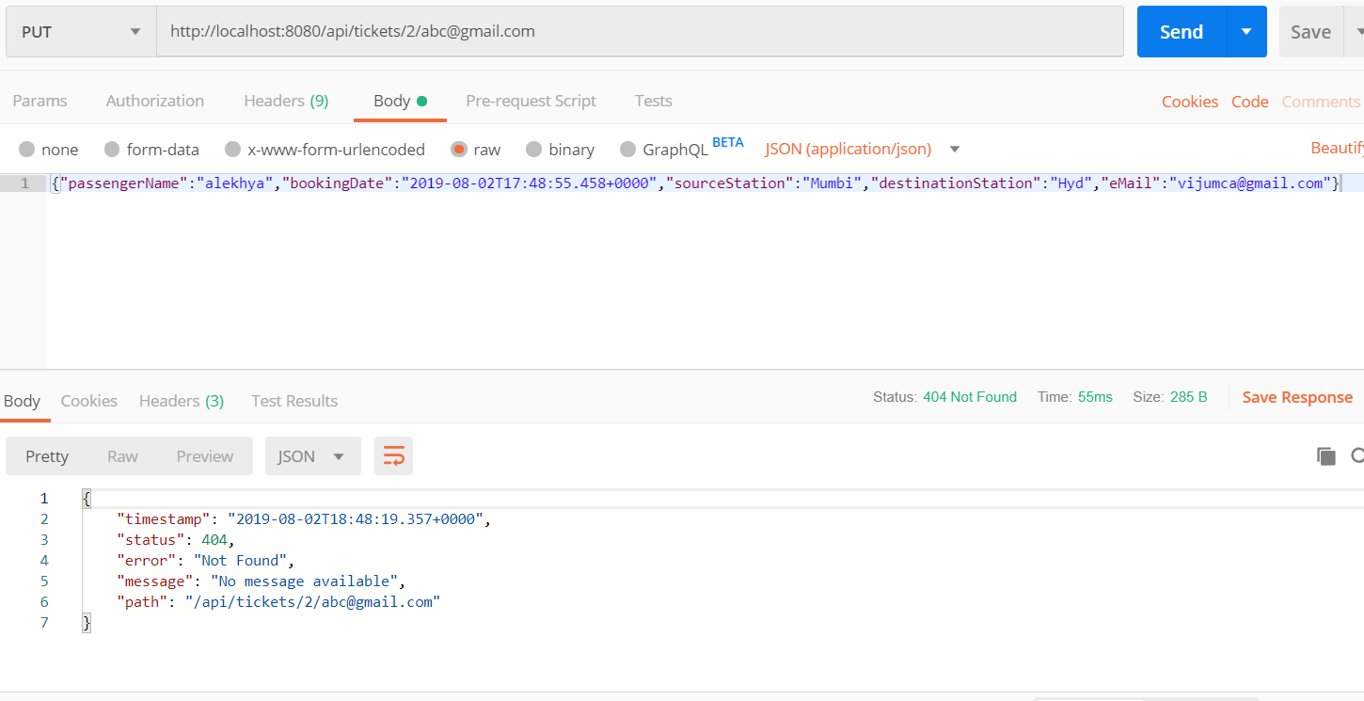

Slide 27
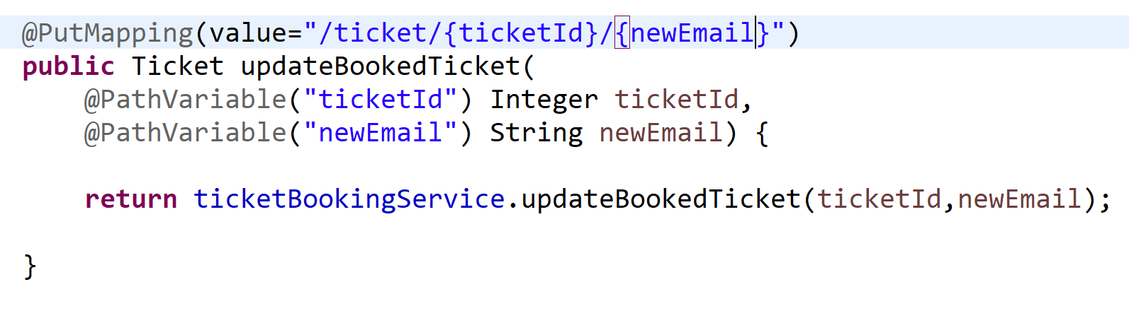
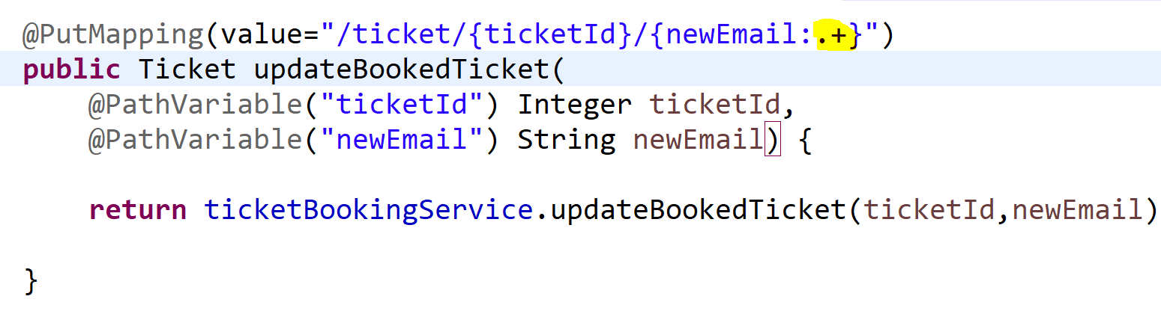

Slide 28
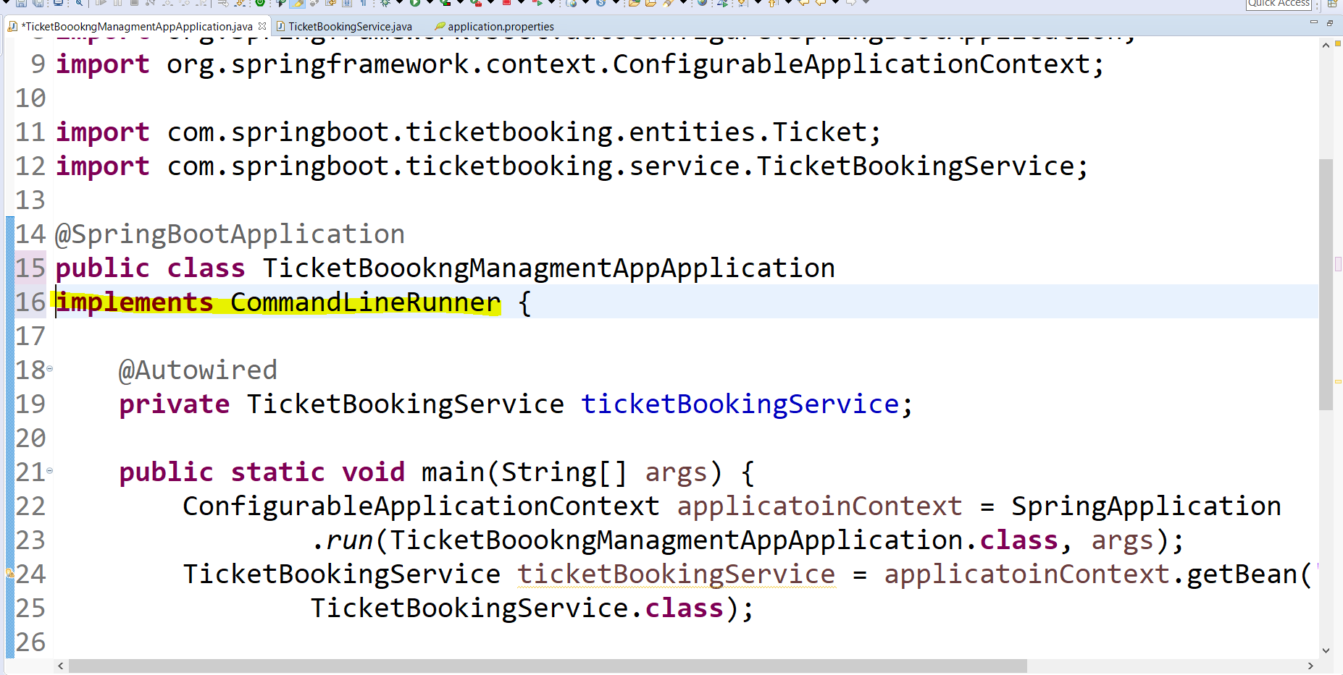

Slide 29
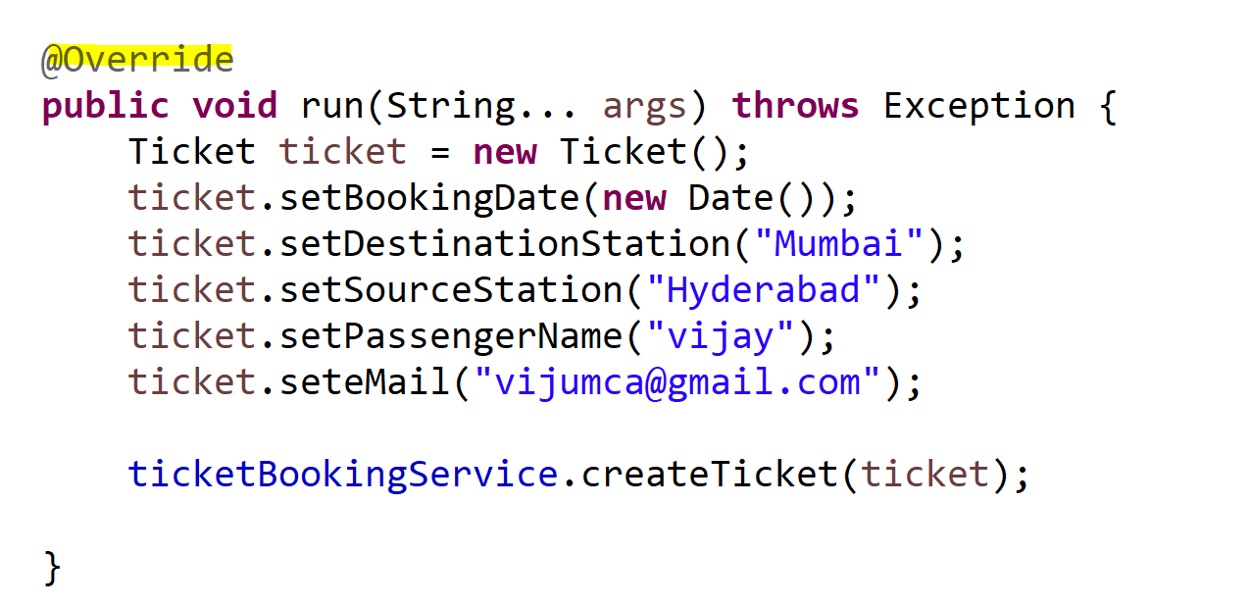

Slide 30
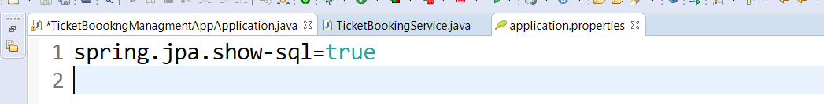
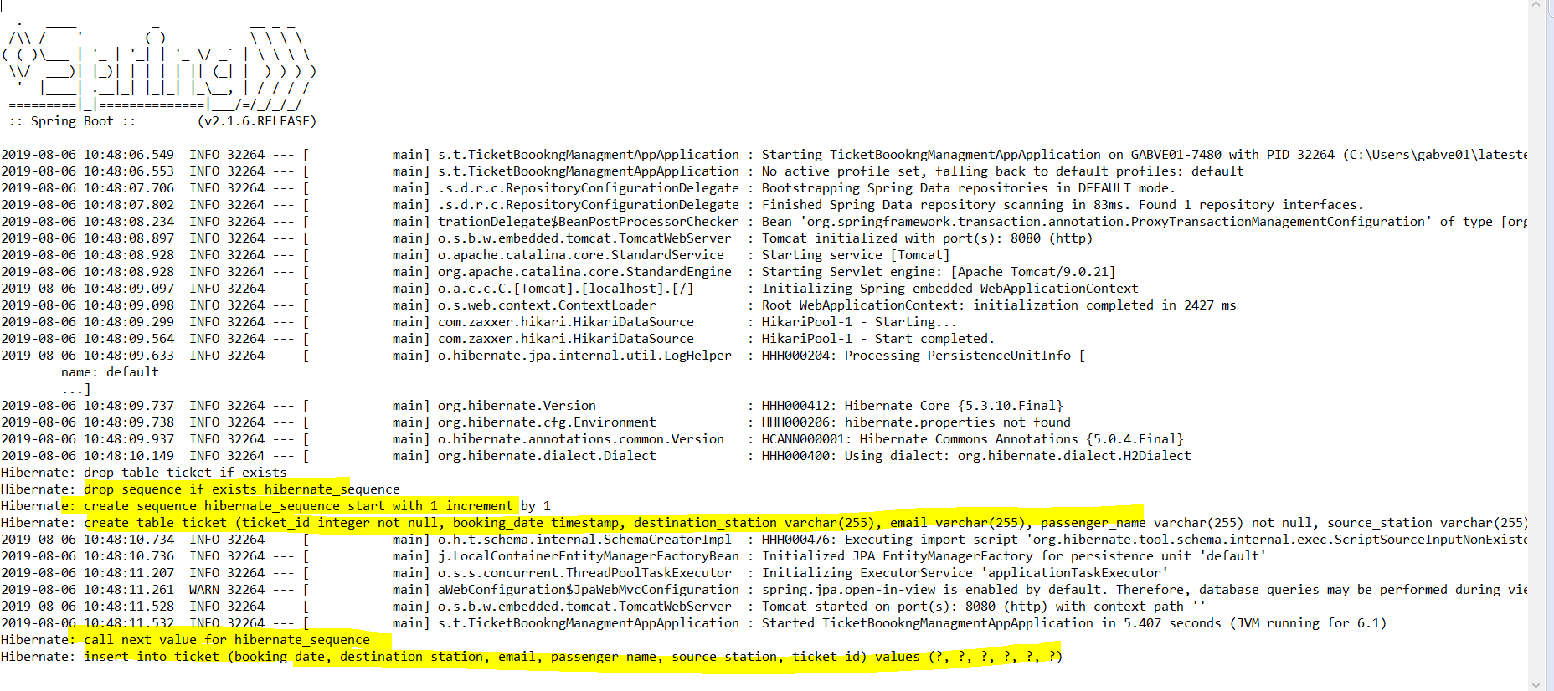

Slide 31
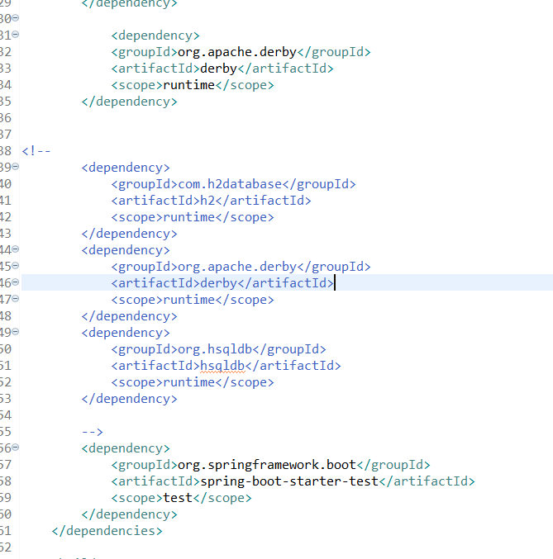

Slide 32
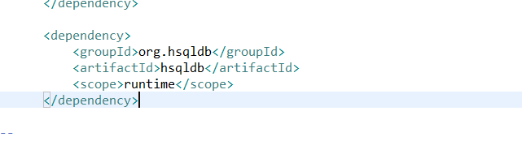

Slide 33
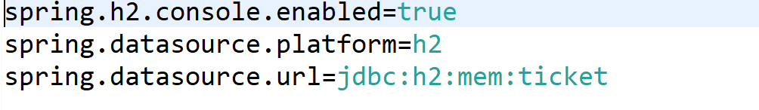

Slide 34
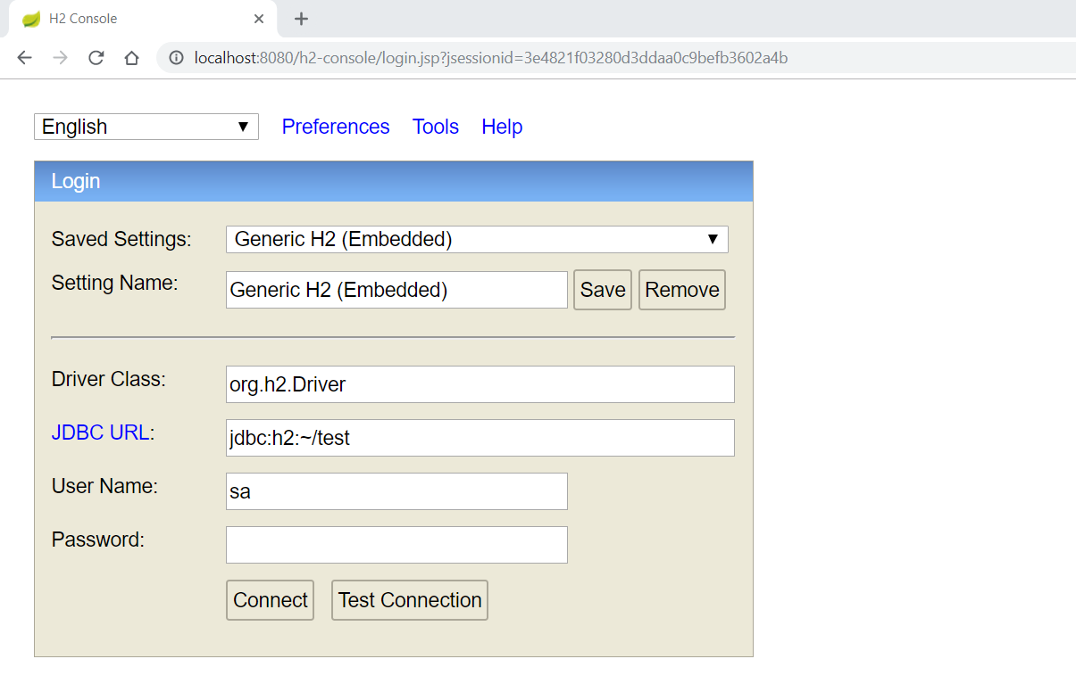

Slide 35
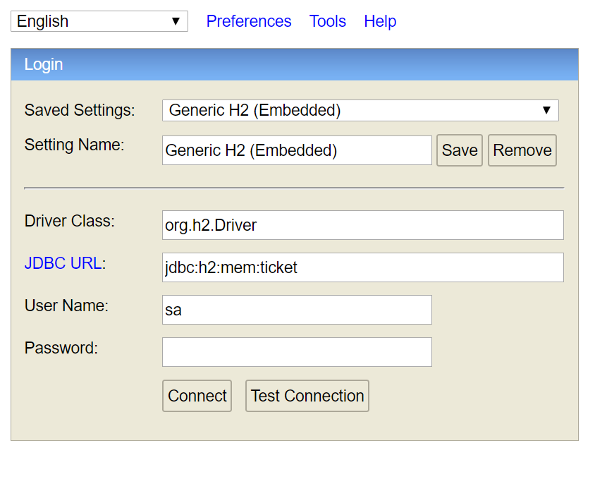

Slide 36
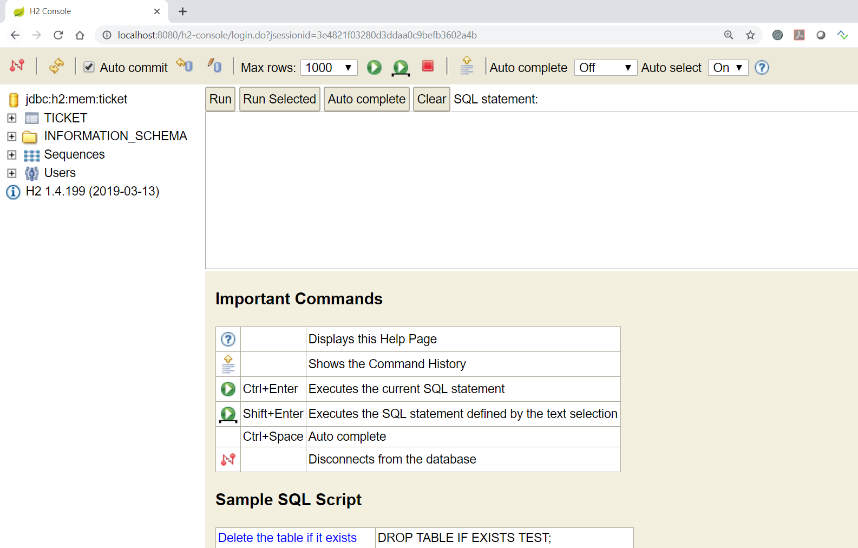
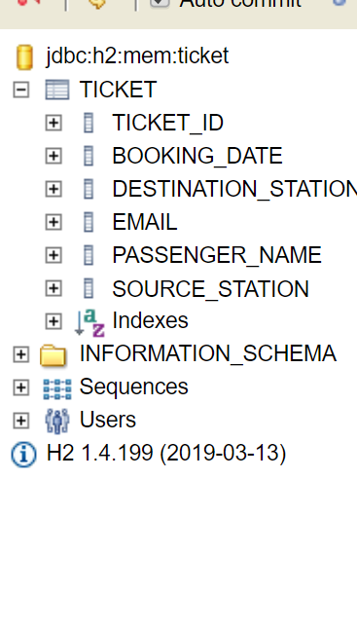

Slide 37
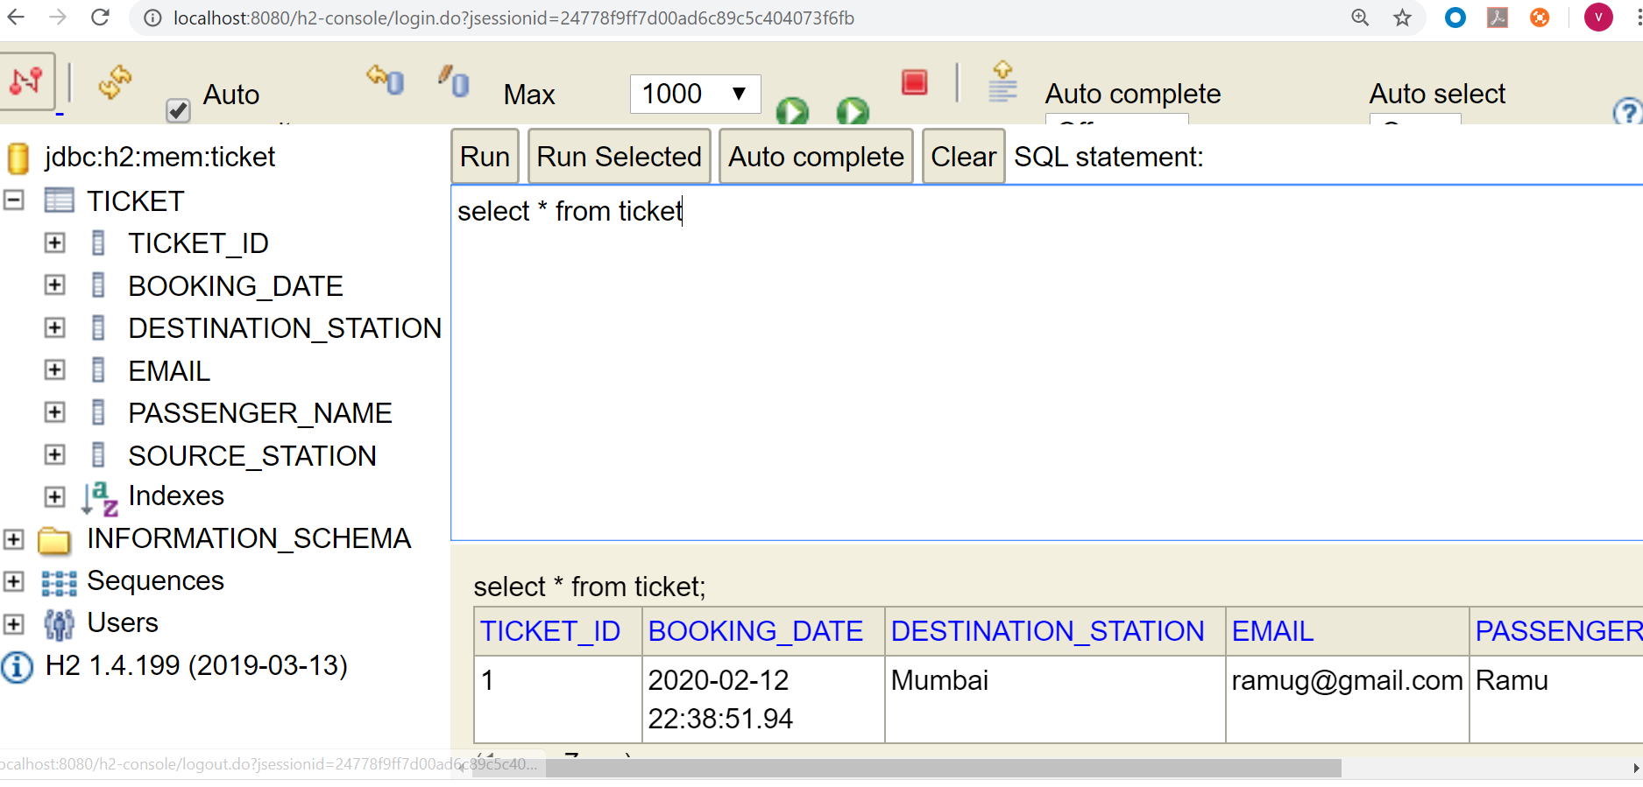

Slide 38
Sybase - Spring boot configuration
<dependency>
<groupId>com.sybase.jconnect</groupId>
<artifactId>jconn4</artifactId>
<version>7.07</version>
<scope>provided</scope>
</dependency>
<dependency>
<groupId>sybase</groupId>
<artifactId>jconn</artifactId>
<version>4_RELEASE</version>
</dependency>
POM.XML
ICONN jar
mvn install:install-file -Dfile="path-to\jconn4.jar" -DgroupId=sybase -DartifactId=jconn -Dversion=4_RELEASE -Dpackaging=jar

Slide 39
Sybase - Spring boot configuration
spring.datasource.url=jdbc:sybase:Tds:HOST:PORT/DB_NAME
spring.datasource.username=USER
spring.datasource.password=PASS
spring.jpa.properties.hibernate.default_schema=SCHEMA
spring.datasource.driverClassName=com.sybase.jdbc4.jdbc.SybDriver
spring.datasource.type=com.zaxxer.hikari.HikariDataSource
spring.jpa.hibernate.ddl-auto=none
spring.jpa.databasePlatform=org.hibernate.dialect.SybaseDialect
spring.datasource.connectionTestQuery=select 1
spring.jpa.show-sql=true
spring.jpa.hibernate.ddl-auto=create
Application Properties File

Slide 40
Oracle Configuration
<dependency>
<groupId>com.oracle.ojdbc</groupId>
<artifactId>ojdbc8</artifactId>
<version>19.3.0.0</version>
</dependency>
POM.XML
Application Properties
spring.datasource.username=student16-pim128
spring.datasource.password=N0tall0wed
spring.datasource.driver.class=oracle.jdbc.driver.OracleDriver
spring.jpa.properties.hibernate.dialect=org.hibernate.dialect.Oracle12cDialect
spring.datasource.driver.class=oracle.jdbc.driver.OracleDriver
spring.jpa.hibernate.ddl-auto=create

Slide 41
SQL SERVER
<dependency>
<groupId>com.microsoft.sqlserver</groupId>
<artifactId>mssql-jdbc</artifactId>
<scope>runtime</scope>
</dependency>
POM.XML
Application Properties
spring.datasource.url=jdbc:sqlserver://10.17.47.225;databaseName=pim128db
spring.datasource.username=sa
spring.datasource.password=N0tall0wed
spring.datasource.driverClassName=com.microsoft.sqlserver.jdbc.SQLServerDriver
spring.jpa.hibernate.dialect=org.hibernate.dialect.SQLServer2012Dialect
spring.jpa.hibernate.ddl-auto=create

Slide 42
MYSQL
<dependency>
<groupId>mysql</groupId>
<artifactId>mysql-connector-java</artifactId>
<scope>runtime</scope>
</dependency>
POM.XML
Application Properties
spring.datasource.url=jdbc:mysql://localhost:3306/ticket8to9batch
spring.datasource.username=root
spring.datasource.password=N0tall0wed
spring.datasource.driver-class-name=com.mysql.cj.jdbc.Driver
spring.jpa.properties.hibernate.dialect=org.hibernate.dialect.MySQL8Dialect
spring.jpa.hibernate.ddl-auto=create

Slide 43
Memory Configuration

